Slide 1
X. Zhang, Y. Xiao, Y. Zhang
Return-Oriented Flush-Reload
Side Channels on ARM and
Their Implications for Android Devices
Xiaokuan Zhang, Yuan Xiao, Yinqian Zhang
Dept. of Computer Science & Engineering
The Ohio State University

Slide 2


X. Zhang, Y. Xiao, Y. Zhang
Cache Side-Channel Attacks
Attacker can learn sensitive information by monitoring cache accesses made by the victim in a shared computer system
Threat model:
Physical Machine

Slide 3
X. Zhang, Y. Xiao, Y. Zhang
Cache Side-Channel Attacks
Prime+Probe
work on cache sets
attacker needs to know virtual-to-physical mapping of the victim
Flush+Reload
work on cache lines
attacker needs physical memory sharing with the victim
Notes:
;

Slide 4
X. Zhang, Y. Xiao, Y. Zhang
Flush-Reload Side-Channel Attack on x86
VICTIM CORE
ATTACKER CORE
L1 CACHE
L2 CACHE
L3 CACHE

Slide 5
X. Zhang, Y. Xiao, Y. Zhang
Flush-Reload Side-Channel Attack on x86
VICTIM CORE
ATTACKER CORE
L1 CACHE
FLUSH
(clflush)
L2 CACHE
L3 CACHE

Slide 6
X. Zhang, Y. Xiao, Y. Zhang
Flush-Reload Side-Channel Attack on x86
VICTIM CORE
ATTACKER CORE
L1 CACHE
FLUSH
(clflush)
L2 CACHE
INCLUSIVE!
L3 CACHE

Slide 7
X. Zhang, Y. Xiao, Y. Zhang
Flush-Reload Side-Channel Attack on x86
VICTIM CORE
ATTACKER CORE
L1 CACHE
FLUSH
(clflush)
L2 CACHE
L3 CACHE

Slide 8
X. Zhang, Y. Xiao, Y. Zhang
Flush-Reload Side-Channel Attack on x86
VICTIM CORE
ATTACKER CORE
L1 CACHE
IDLE
L2 CACHE
L3 CACHE

Slide 9
X. Zhang, Y. Xiao, Y. Zhang
Flush-Reload Side-Channel Attack on x86
VICTIM CORE
ATTACKER CORE
L1 CACHE
IDLE
L2 CACHE
L3 CACHE

Slide 10
X. Zhang, Y. Xiao, Y. Zhang
Flush-Reload Side-Channel Attack on x86
VICTIM CORE
ATTACKER CORE
RELOAD&TIME
(rdtsc)
L1 CACHE
L2 CACHE
L3 CACHE

Slide 11
X. Zhang, Y. Xiao, Y. Zhang
Flush-Reload Side-Channel Attack on x86
VICTIM CORE
ATTACKER CORE
RELOAD&TIME
(rdtsc)
L1 CACHE
FAST
L2 CACHE
IN L3 CACHE
L3 CACHE
ACCESSED
BY VICTIM

Slide 12
X. Zhang, Y. Xiao, Y. Zhang
Flush-Reload Side-Channel Attack on x86
FLUSH
IDLE
RELOAD
FLUSH
IDLE
RELOAD
FLUSH-RELOAD
INTERVAL
FLUSH-RELOAD
INTERVAL
FLUSH-RELOAD
CYCLE
FAST → ACCESS
SLOW → NO ACCESS
Notes:
FLUSH: A flushes a chunk locating in a shared memory page using clflush, and it contains specific instructions.
IDLE: A waits for a pre-determined interval while B is accessing the last level cache on another CPU core.
RELOAD: A measures the time of reloading the same chunk into the cache.
If the time is shorter, it means that these instructions has been already in the cache. In other words, B has executed these instructions.

Slide 13
X. Zhang, Y. Xiao, Y. Zhang
Flush-Reload on ARM
“Flush-Reload is not applicable on ARM”
--- [Yarom et al., Security’14]

Slide 14
X. Zhang, Y. Xiao, Y. Zhang
OUTLINE
ARM Cache Exploration
Return-Oriented Flush-Reload Attacks on ARM
Case studies on Android
Conclusion

Slide 15
X. Zhang, Y. Xiao, Y. Zhang
Challenges
 | Intel | ARM
Unprivileged Cache Flush Instruction | clflush | ???
Cache Inclusiveness | Inclusive last-level cache | ???
Note: Last-level cache on ARM is L2 cache
Notes:
Talk about LLC is L2 on ARM

Slide 16
X. Zhang, Y. Xiao, Y. Zhang
LLC Flush-Reload Requirements
Flush:
Local L1 cache
Shared L2 cache
L1 cache of other cores
L2 cache:
Victim’s memory access must put the cache line into L2 cache

Slide 17
X. Zhang, Y. Xiao, Y. Zhang
LLC Flush-Reload Requirements
Flush:
Local L1 cache
Shared L2 cache
L1 cache of other cores
L2 cache:
Victim’s memory access must put the cache line into L2 cache
see changes in L2 cache

Slide 18
X. Zhang, Y. Xiao, Y. Zhang
LLC Flush-Reload Requirements
Flush:
Local L1 cache
Shared L2 cache
L1 cache of other cores
L2 cache:
Victim’s memory access must put the cache line into L2 cache

Slide 19
X. Zhang, Y. Xiao, Y. Zhang
LLC Flush-Reload Requirements: Flush(3)
VICTIM CORE
ATTACKER CORE
FLUSH
L1 CACHE
L2 CACHE

Slide 20
X. Zhang, Y. Xiao, Y. Zhang
LLC Flush-Reload Requirements: Flush(3)
VICTIM CORE
ATTACKER CORE
FLUSH
L1 CACHE
L2 CACHE

Slide 21
X. Zhang, Y. Xiao, Y. Zhang
LLC Flush-Reload Requirements: Flush(3)
VICTIM CORE
ATTACKER CORE
RELOAD&TIME
L1 CACHE
L2 CACHE
Memory
Access
Time

Slide 22
X. Zhang, Y. Xiao, Y. Zhang
LLC Flush-Reload Requirements
Flush:
Local L1 cache
Shared L2 cache
L1 cache of other cores
L2 cache:
Victim’s memory access must put the cache line into L2 cache

Slide 23
X. Zhang, Y. Xiao, Y. Zhang
LLC Flush-Reload Requirements: LLC
VICTIM CORE
ATTACKER CORE
FLUSH
L1 CACHE
L2 CACHE

Slide 24
X. Zhang, Y. Xiao, Y. Zhang
LLC Flush-Reload Requirements: LLC
VICTIM CORE
ATTACKER CORE
FLUSH
L1 CACHE
L2 CACHE

Slide 25
X. Zhang, Y. Xiao, Y. Zhang
LLC Flush-Reload Requirements: LLC
VICTIM CORE
ATTACKER CORE
IDLE
L1 CACHE
L2 CACHE

Slide 26
X. Zhang, Y. Xiao, Y. Zhang
LLC Flush-Reload Requirements: LLC
VICTIM CORE
ATTACKER CORE
RELOAD&TIME
L1 CACHE
L2 CACHE
Memory
Access
Time

Slide 27
X. Zhang, Y. Xiao, Y. Zhang
LLC Flush-Reload Requirements
Flush:
Local L1 cache
Shared L2 cache
L1 cache of other cores
L2 cache:
Victim’s memory access must put the cache line into L2 cache

Slide 28
X. Zhang, Y. Xiao, Y. Zhang
Cache Flush Interface
Attack model: zero-permission Android app
need to find a userspace cache flush interface
Userspace: clearcache system call
no privilege required
support self-modifying code
no specification on how to implement
Need to empirically study its effect
Flushes I-cache
Notes:
Our attack model is that the attacker can use a zero-permission Android app to perform the attack. Therefore, we need to find a cache flush interface that we can use without any privileges.
Clearcache is a system call that is accessible by unprivileged Android
apps. ARM does not maintain cache coherence between data cache and
instruction cache. To run self-modifying code, the application itself must use clearcache system call to clear the staled code from the instruction cache after the code has been modified on the data side. Therefore, clearcache is designed to flush only the instruction cache. However, ARM specification does not specify how this system call is implemented. That is, whether flushing L1 instruction cache will also flush the shared L2 cache, which is a requirement for our attack. Therefore, we need to design novel methods to empirically determine the effect of clearcache.

Slide 29
X. Zhang, Y. Xiao, Y. Zhang
Cache Flush Interface: clearcache
Effect of clearcache:
Local L1 cache?
Shared L2 cache?
L1 cache of other cores?
Experiment:
Zero-permission Android app with NDK
Two threads running on two cores
1K dummy function (consists of “nop”)

Slide 30

X. Zhang, Y. Xiao, Y. Zhang
Cache Flush Interface: clearcache
Thread A
Thread B
A: Execute Dummy
Core 0
Core 1
B: Idle
L2 CACHE

Slide 31
X. Zhang, Y. Xiao, Y. Zhang
Cache Flush Interface: clearcache
Thread A
Thread B
A: Execute Dummy
Core 0
Core 1
T1: L1 Access Time
B: Idle
L2 CACHE

Slide 32
X. Zhang, Y. Xiao, Y. Zhang
Cache Flush Interface: clearcache
Thread A
Thread B
Core 0
Core 1
T1: L1 Access Time
A: Cleanse L1+L2
Execute Dummy
B: Idle
L2 CACHE

Slide 33
X. Zhang, Y. Xiao, Y. Zhang
Cache Flush Interface: clearcache
Thread A
Thread B
Core 0
Core 1
T1 L1 Access Time
A: Cleanse L1+L2
T1: L1 Access Time
Execute Dummy
B: Idle
L2 CACHE

Slide 34
X. Zhang, Y. Xiao, Y. Zhang
Cache Flush Interface: clearcache
Thread A
Thread B
Core 0
Core 1
T1 L1 Access Time
T1 L1 Access Time
A: Cleanse L1+L2
T1: L1 Access Time
Execute Dummy
B: Idle
L2 CACHE

Slide 35
X. Zhang, Y. Xiao, Y. Zhang
Cache Flush Interface: clearcache
Thread A
Thread B
Core 0
Core 1
T1 L1 Access Time
A: Cleanse L1+L2
T1: L1 Access Time
Execute Dummy
B: Idle
T4:Memory Access Time
L2 CACHE

Slide 36
X. Zhang, Y. Xiao, Y. Zhang
Cache Flush Interface: clearcache
Thread A
Thread B
Core 0
Core 1
T1 L1 Access Time
A: Clearcache
T1: L1 Access Time
T2:Effects of Clearcache
On Local Core
Execute Dummy
???
B: Idle
T4:Memory Access Time
???
L2 CACHE

Slide 37
X. Zhang, Y. Xiao, Y. Zhang
Cache Flush Interface: clearcache
Thread A
Thread B
A: Execute Dummy
Core 0
Core 1
T1 L1 Access Time
T1: L1 Access Time
T2:Effects of Clearcache
On Local Core
???
T3:Effects of Clearcache
On Another Core
B: Clearcache
T4:Memory Access Time
???
L2 CACHE

Slide 38
X. Zhang, Y. Xiao, Y. Zhang
Cache Flush Interface: clearcache
Measurement | Thread A | Thread B | PURPOSE
T1 | Execute Dummy | Idle | L1 cache access time
T2 | Clearcache, Execute Dummy | Idle | effects of clearcache on local core
T3 | Execute Dummy | Clearcache | effects of clearcache on a different core
T4 | Cleanse L1+L2, Execute Dummy | Idle | memory access time

Slide 39
X. Zhang, Y. Xiao, Y. Zhang
Cache Flush Interface: clearcache
Measurement | Thread A | Thread B | PURPOSE
T1 | Execute Dummy | Idle | L1 cache access time
T2 | Clearcache, Execute Dummy | Idle | effects of clearcache on local core
T3 | Execute Dummy | Clearcache | effects of clearcache on a different core
T4 | Cleanse L1+L2, Execute Dummy | Idle | memory access time

Slide 40
X. Zhang, Y. Xiao, Y. Zhang
Cache Flush Interface: clearcache
Measurement | Thread A | Thread B | PURPOSE
T1 | Execute Dummy | Idle | L1 cache access time
T2 | Clearcache, Execute Dummy | Idle | effects of clearcache on local core
T3 | Execute Dummy | Clearcache | effects of clearcache on a different core
T4 | Cleanse L1+L2, Execute Dummy | Idle | memory access time

Slide 41
X. Zhang, Y. Xiao, Y. Zhang
Cache Flush Interface: clearcache
Measurement | Thread A | Thread B | PURPOSE
T1 | Execute Dummy | Idle | L1 cache access time
T2 | Clearcache, Execute Dummy | Idle | effects of clearcache on local core
T3 | Execute Dummy | Clearcache | effects of clearcache on a different core
T4 | Cleanse L1+L2, Execute Dummy | Idle | memory access time

Slide 42
X. Zhang, Y. Xiao, Y. Zhang
Testbed
 | Samsung Galaxy S5 | Samsung Galaxy S6 | Google Nexus 6
Number of CPUs | 2 | 2 | 1
Architecture | 32-bit ARMv7 | 64-bit ARMv8 | 32-bit ARMv7
CPU Type | Cortex-A15 Cortex-A70 | Cortex-A57 Cortex-A53 | Krait 450

Slide 43
X. Zhang, Y. Xiao, Y. Zhang
Clearcache Experiment Result

Slide 44
X. Zhang, Y. Xiao, Y. Zhang
Clearcache Experiment Result

Slide 45
X. Zhang, Y. Xiao, Y. Zhang
LLC Flush-Reload Requirements
Flush:
Local L1 cache
Shared L2 cache
L1 cache of other cores
L2 cache:
Victim’s memory access must put the cache line into L2 cache

Slide 46
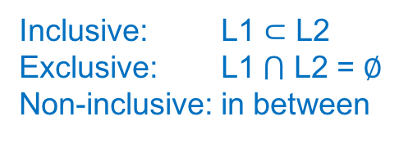
X. Zhang, Y. Xiao, Y. Zhang
Cache Inclusiveness
Is L2 cache inclusive, exclusive or non-inclusive to L1 cache?
Inclusive: L1 $⊂$ L2
Exclusive: L1$⋂$ L2 = $∅$
Non-inclusive: in between

Slide 47
X. Zhang, Y. Xiao, Y. Zhang
Cache Inclusiveness
Experiment: timing side channel
All 5 processors have inclusive L2 cache

Slide 48
X. Zhang, Y. Xiao, Y. Zhang
Recall: LLC Flush-Reload Requirements
Flush:
Local L1 cache
Shared L2 cache
L1 cache of other cores
L2 cache:
Victim’s memory access must put the cache line into L2 cache
Cortex A57&A53 !!!
Notes:
we demonstrate our attacks on S6. As they , we anticipate …
Actually, this is a general method to determine whether a processor is vulnerable to F-R attacks.

Slide 49
X. Zhang, Y. Xiao, Y. Zhang
OUTLINE
ARM Cache Exploration
Return-Oriented Flush-Reload Attacks on ARM
Case studies on Android
Conclusion

Slide 50
X. Zhang, Y. Xiao, Y. Zhang
Challenges: Reload Using Instruction Cache
Can only use instruction cache reload
Have to execute an entire function
Need to reconstruct program semantics
Execution time of a function may vary
Flush and Reload take too long

Slide 51
X. Zhang, Y. Xiao, Y. Zhang
Return-Oriented Programming
Victim Program
Shared Libraries
Stack
Libraries
ADD Gadget ret
Heap
LOAD Gadget ret
Return Address 1
STORE Gadget ret
Return Address 2
Return Address 3
ATTACKER

Slide 52
X. Zhang, Y. Xiao, Y. Zhang
Return-Oriented Reloads: Basic Idea
Android App
Shared Library
T1 = Timer();
Jump Gadget1;
Jump Gadget2;
Jump Gadget3;
T2 = Timer();
Gadget1 return
Gadget2 return
Gadget3 return

Slide 53
X. Zhang, Y. Xiao, Y. Zhang
Return-Oriented Reloads: Basic Idea
Android App
Shared Library
T1 = Timer();
Jump Gadget1;
Jump Gadget2;
Jump Gadget3;
T2 = Timer();
Gadget1 return
Gadget2 return
Gadget3 return

Slide 54
X. Zhang, Y. Xiao, Y. Zhang
Return-Oriented Reloads: Basic Idea
Android App
Shared Library
T1 = Timer();
Jump Gadget1;
Jump Gadget2;
Jump Gadget3;
T2 = Timer();
Gadget1 return
Gadget2 return
Gadget3 return

Slide 55
X. Zhang, Y. Xiao, Y. Zhang
Return-Oriented Reloads: Basic Idea
Android App
Shared Library
T1 = Timer();
Jump Gadget1;
Jump Gadget2;
Jump Gadget3;
T2 = Timer();
Gadget1 return
Gadget2 return
Gadget3 return

Slide 56
X. Zhang, Y. Xiao, Y. Zhang
Return-Oriented Reloads: Basic Idea
Android App
Shared Library
T1 = Timer();
Jump Gadget1;
Jump Gadget2;
Jump Gadget3;
T2 = Timer();
Gadget1 return
Gadget2 return
Gadget3 return

Slide 57
X. Zhang, Y. Xiao, Y. Zhang
Return-Oriented Reloads: Basic Idea
Android App
Shared Library
T1 = Timer();
Jump Gadget1;
Jump Gadget2;
Jump Gadget3;
T2 = Timer();
Gadget1 return
Gadget2 return
Gadget3 return

Slide 58
X. Zhang, Y. Xiao, Y. Zhang
Return-Oriented Reloads: Basic Idea
Android App
Shared Library
T1 = Timer();
Jump Gadget1;
Jump Gadget2;
Jump Gadget3;
T2 = Timer();
Gadget1 return
Gadget2 return
Gadget3 return

Slide 59
X. Zhang, Y. Xiao, Y. Zhang
Return-Oriented Reloads: Basic Idea
Android App
Shared Library
T1 = Timer();
Jump Gadget1;
Jump Gadget2;
Jump Gadget3;
T2 = Timer();
Gadget1 return
Gadget2 return
Gadget3 return

Slide 60
X. Zhang, Y. Xiao, Y. Zhang
Return-Oriented Reloads: Basic Idea
Android App
Shared Library
T1 = Timer();
Jump Gadget1;
Jump Gadget2;
Jump Gadget3;
T2 = Timer();
Gadget1 return
Gadget2 return
Reload=T2-T1
Gadget3 return

Slide 61
X. Zhang, Y. Xiao, Y. Zhang
Indirect Control-flow Transfer Instructions
Architecture | Instruction | Effect
ARM v7 (32 bit) | bx lr | PC := lr
 | bx r_{m} | PC := r_{m}
 | blx r_{m} | lr (r₁₄) := next instruction PC := r_{m}
 | mov pc, lr | PC := lr
 | pop {pc} | PC := top of stack
 | ldm {pc} | load multiple registers

Slide 62
X. Zhang, Y. Xiao, Y. Zhang
Indirect Control-flow Transfer Instructions
Architecture | Instruction | Effect
ARM v8 (64 bit) | br x_{m} | PC := x_{m}
 | blr x_{m} | lr (x₃₀) := next instruction PC := x_{m}
 | ret x_{m} | PC := x_{m}
 | ret | PC := lr

Slide 63
X. Zhang, Y. Xiao, Y. Zhang
Return-Oriented Reloads: Example
Android App
libc.so
mov x19, 0x246a0
mov x20, x30
Label: adr x4, Label
add x4, x4, #12
br x19
mov x30, x20
mov x19, 0x246fc
blr x19
…
0x24670 <clock_gettime>
X19
0x246a0 blr x4
0x246fc ret

Slide 64
X. Zhang, Y. Xiao, Y. Zhang
Return-Oriented Reloads: Example
Android App
libc.so
mov x19, 0x246a0
mov x20, x30
Label: adr x4, Label
add x4, x4, #12
br x19
mov x30, x20
mov x19, 0x246fc
blr x19
…
0x24670 <clock_gettime>
0x246a0 blr x4
0x246fc ret

Slide 65
X. Zhang, Y. Xiao, Y. Zhang
Return-Oriented Reloads: Example
Android App
libc.so
mov x19, 0x246a0
mov x20, x30
Label: adr x4, Label
add x4, x4, #12
br x19
mov x30, x20
mov x19, 0x246fc
blr x19
…
0x24670 <clock_gettime>
0x246a0 blr x4
0x246fc ret

Slide 66
X. Zhang, Y. Xiao, Y. Zhang
Return-Oriented Reloads: Example
Android App
libc.so
mov x19, 0x246a0
mov x20, x30
Label: adr x4, Label
add x4, x4, #12
br x19
mov x30, x20
mov x19, 0x246fc
blr x19
…
0x24670 <clock_gettime>
0x246a0 blr x4
X4
0x246fc ret

Slide 67
X. Zhang, Y. Xiao, Y. Zhang
Return-Oriented Reloads: Example
Android App
libc.so
mov x19, 0x246a0
mov x20, x30
Label: adr x4, Label
add x4, x4, #12
br x19
mov x30, x20
mov x19, 0x246fc
blr x19
…
0x24670 <clock_gettime>
0x246a0 blr x4
0x246fc ret

Slide 68
X. Zhang, Y. Xiao, Y. Zhang
Return-Oriented Reloads: Example
Android App
libc.so
mov x19, 0x246a0
mov x20, x30
Label: adr x4, Label
add x4, x4, #12
br x19
mov x30, x20
mov x19, 0x246fc
blr x19
…
0x24670 <clock_gettime>
0x246a0 blr x4
0x246fc ret

Slide 69
X. Zhang, Y. Xiao, Y. Zhang
Return-Oriented Reloads: Example
Android App
libc.so
mov x19, 0x246a0
mov x20, x30
Label: adr x4, Label
add x4, x4, #12
br x19
mov x30, x20
mov x19, 0x246fc
blr x19
…
0x24670 <clock_gettime>
0x246a0 blr x4
0x246fc ret

Slide 70
X. Zhang, Y. Xiao, Y. Zhang
Return-Oriented Reloads: Example
Android App
libc.so
mov x19, 0x246a0
mov x20, x30
Label: adr x4, Label
add x4, x4, #12
br x19
mov x30, x20
mov x19, 0x246fc
blr x19
…
0x24670 <clock_gettime>
0x246a0 blr x4
0x246fc ret

Slide 71
X. Zhang, Y. Xiao, Y. Zhang
Return-Oriented Reloads: Example
Android App
libc.so
mov x19, 0x246a0
mov x20, x30
Label: adr x4, Label
add x4, x4, #12
br x19
mov x30, x20
mov x19, 0x246fc
blr x19
…
0x24670 <clock_gettime>
0x246a0 blr x4
X19
0x246fc ret

Slide 72
X. Zhang, Y. Xiao, Y. Zhang
Return-Oriented Reloads: Example
Android App
libc.so
mov x19, 0x246a0
mov x20, x30
Label: adr x4, Label
add x4, x4, #12
br x19
mov x30, x20
mov x19, 0x246fc
blr x19
…
0x24670 <clock_gettime>
0x246a0 blr x4
0x246fc ret

Slide 73
X. Zhang, Y. Xiao, Y. Zhang
Return-Oriented Reloads: Example
Android App
libc.so
mov x19, 0x246a0
mov x20, x30
Label: adr x4, Label
add x4, x4, #12
br x19
mov x30, x20
mov x19, 0x246fc
blr x19
…
0x24670 <clock_gettime>
0x246a0 blr x4
0x246fc ret

Slide 74
X. Zhang, Y. Xiao, Y. Zhang
Return-Oriented Reloads: Example
Android App
libc.so
mov x19, 0x246a0
mov x20, x30
Label: adr x4, Label
add x4, x4, #12
br x19
mov x30, x20
mov x19, 0x246fc
blr x19
…
0x24670 <clock_gettime>
0x246a0 blr x4
0x246fc ret

Slide 75
X. Zhang, Y. Xiao, Y. Zhang
Return-Oriented Reloads: Example
Android App
libc.so
mov x19, 0x246a0
mov x20, x30
Label: adr x4, Label
add x4, x4, #12
br x19
mov x30, x20
mov x19, 0x246fc
blr x19
…
0x24670 <clock_gettime>
0x246a0 blr x4
0x246fc ret

Slide 76
X. Zhang, Y. Xiao, Y. Zhang
OUTLINE
ARM Cache Exploration
Return-Oriented Flush-Reload Attacks on ARM
Case studies on Android
Conclusion

Slide 77
X. Zhang, Y. Xiao, Y. Zhang
Case Studies on Android
Testbed: Samsung Galaxy S6, Android 5.1.1
Two categories of attacks:
detecting hardware events
tracing software execution paths
--- Touchscreen
--- SurfaceFlinger

Slide 78
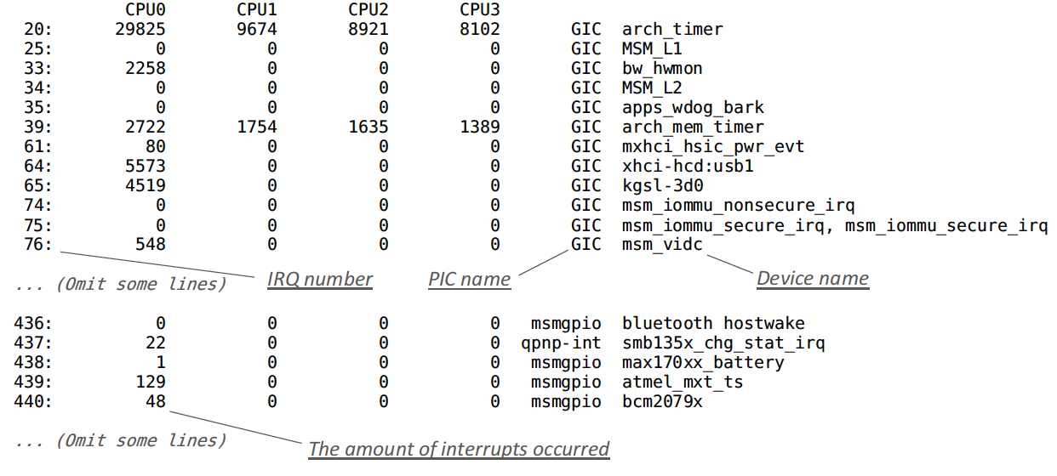
X. Zhang, Y. Xiao, Y. Zhang
An Interrupt-based Touchscreen Side Channel
[Diao et al., SP’16]
/proc/interrupts

Slide 79
X. Zhang, Y. Xiao, Y. Zhang
An Interrupt-based Touchscreen Side Channel
[Diao et al., SP’16]
/proc/interrupts
Interrupt Time Series

Slide 80
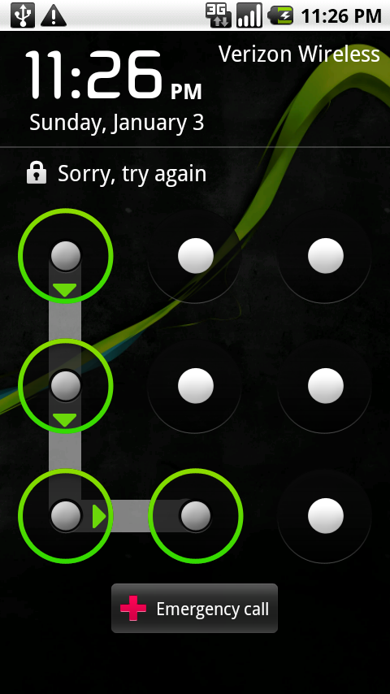
X. Zhang, Y. Xiao, Y. Zhang
An Interrupt-based Touchscreen Side Channel
[Diao et al., SP’16]
/proc/interrupts
Interrupt Time Series
Unlock Pattern

Slide 81
X. Zhang, Y. Xiao, Y. Zhang
An Interrupt-based Touchscreen Side Channel
[Diao et al., SP’16]
/proc/interrupts
Interrupt Time Series
Unlock Pattern

Slide 82
X. Zhang, Y. Xiao, Y. Zhang
Partial Workflow of Android Touch Events
EventHub
HAL
/dev/input/eventX
Input Event
Driver
Call input_sync()
Flush-Reload
Touchscreen Driver
Linux Kernel
touch
Touchscreen
Hardware

Slide 83
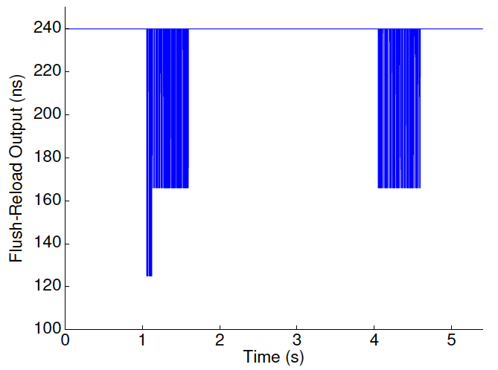
X. Zhang, Y. Xiao, Y. Zhang
Partial Workflow of Android Display System
Application
SystemUI
Hardware IndependentLayer
Surface
Surface
BufferQueue
BufferQueue
SurfaceFlinger
(compose buffers)
Call postFrameBuffer()
Flush-Reload
Hardware
Composer
HAL

Slide 84
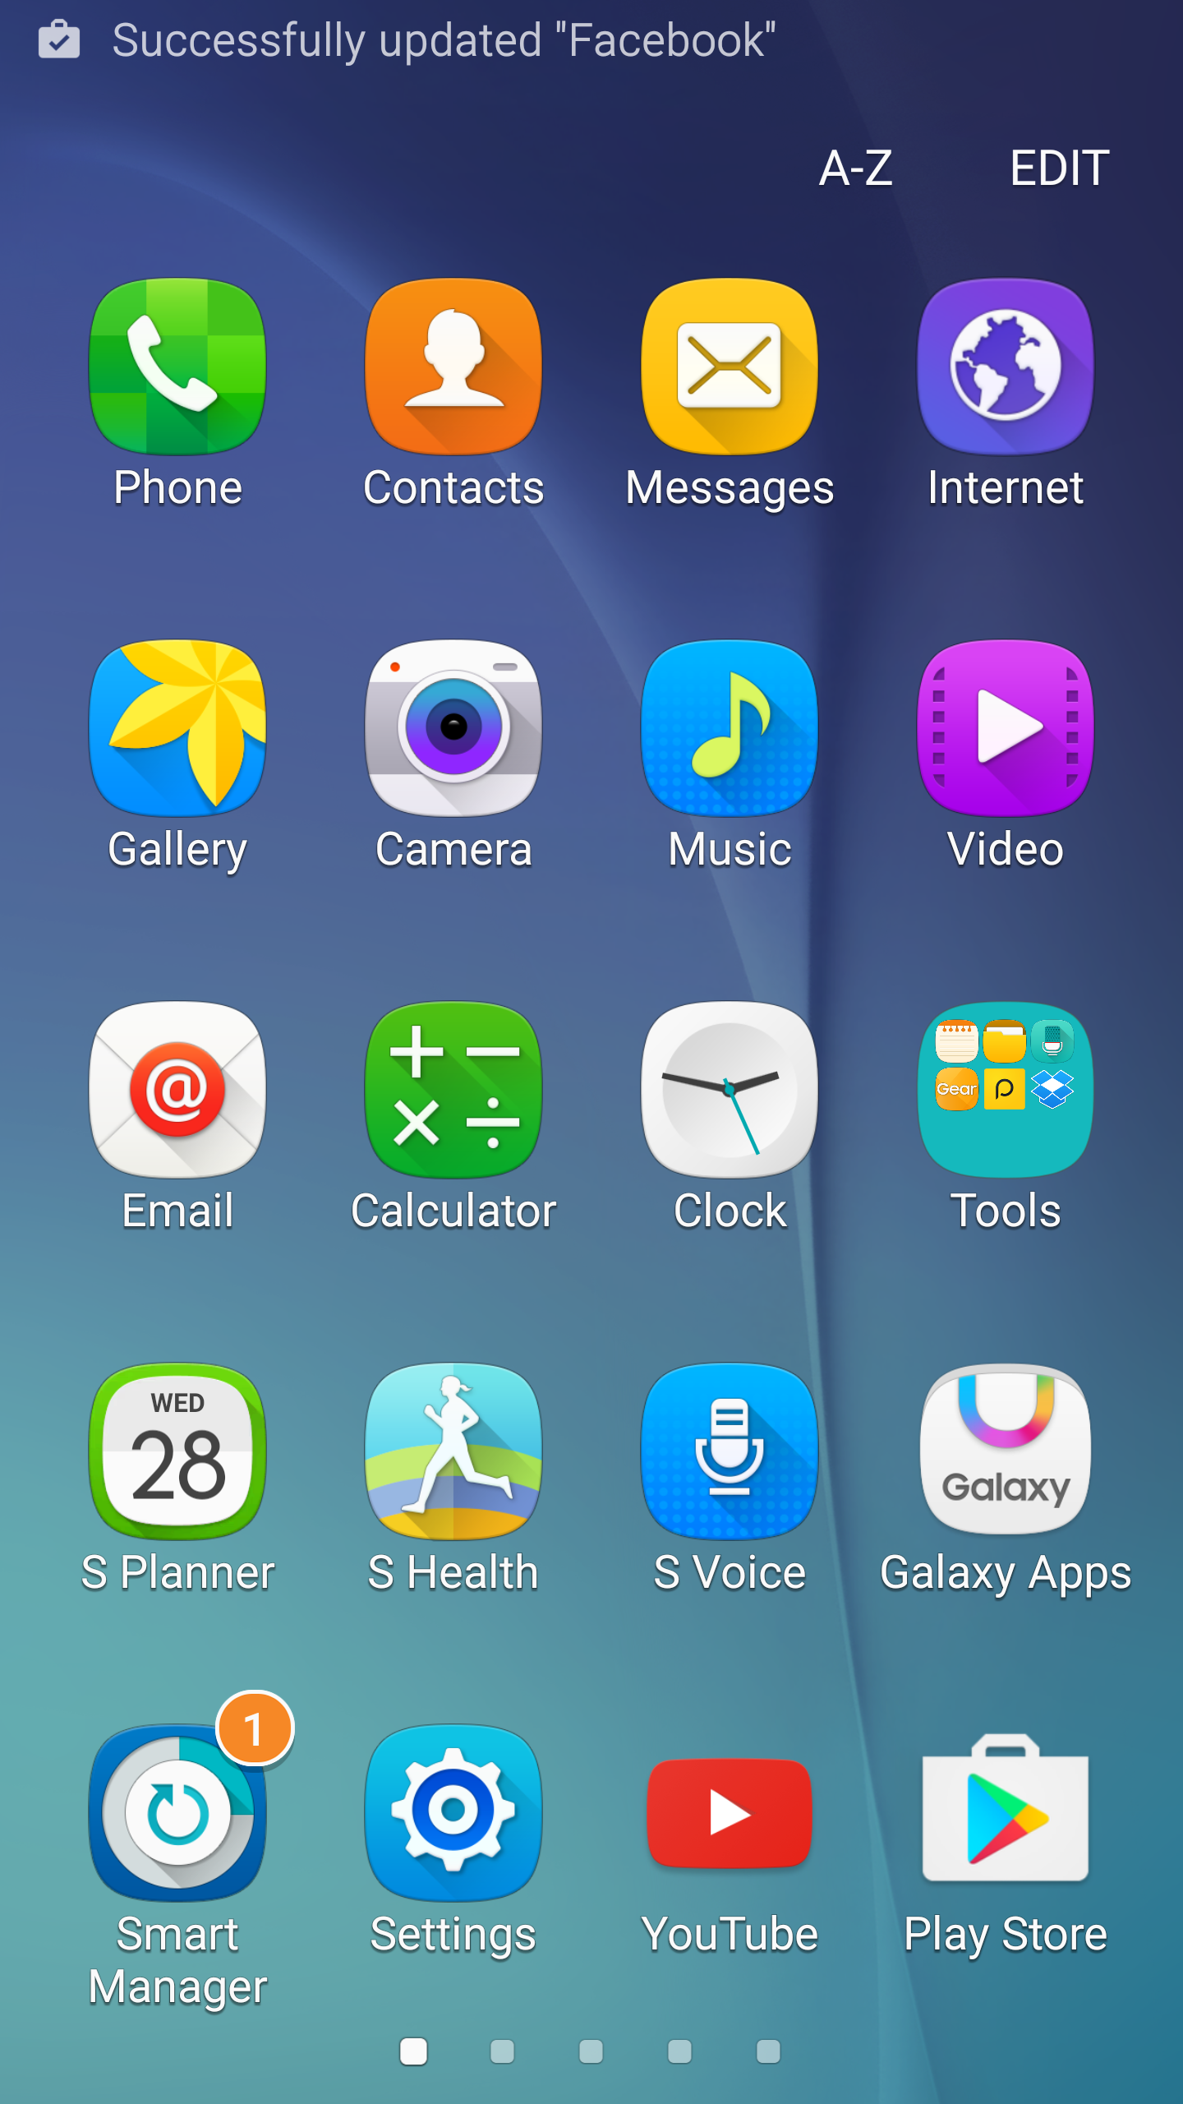
X. Zhang, Y. Xiao, Y. Zhang
Detecting Push Notifications
3s
infer user’s private action
Notes:
line chart
low reading

Slide 85
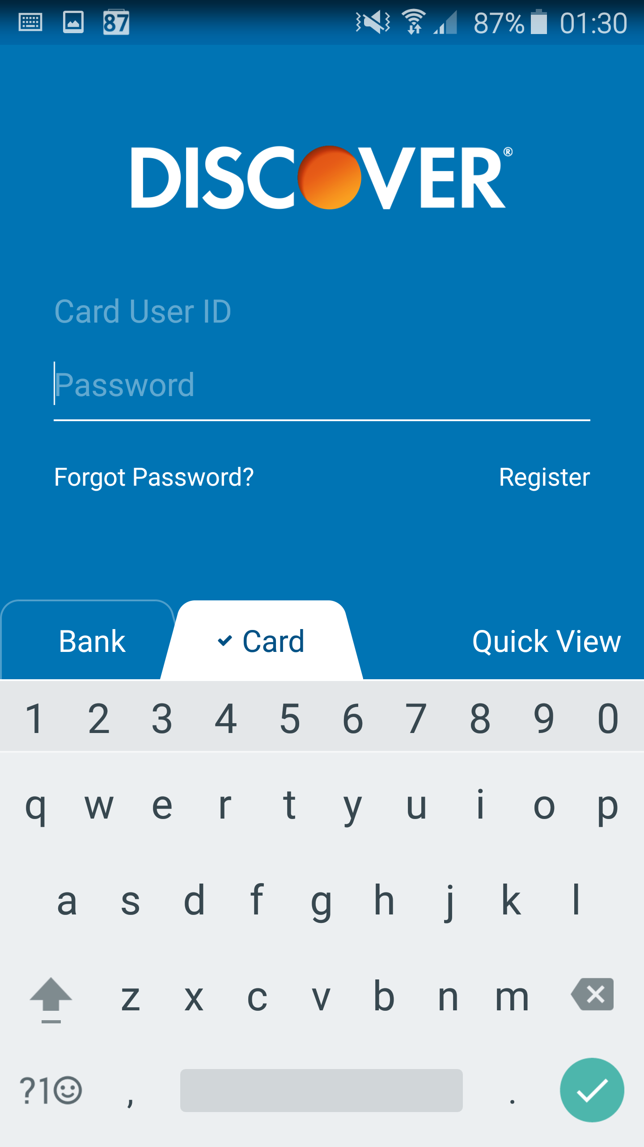
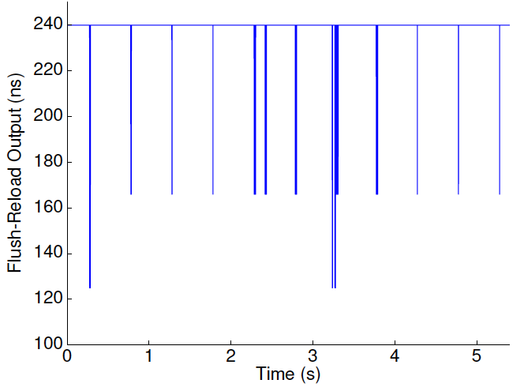
X. Zhang, Y. Xiao, Y. Zhang
Detecting Display Updates
0.5s

Slide 86

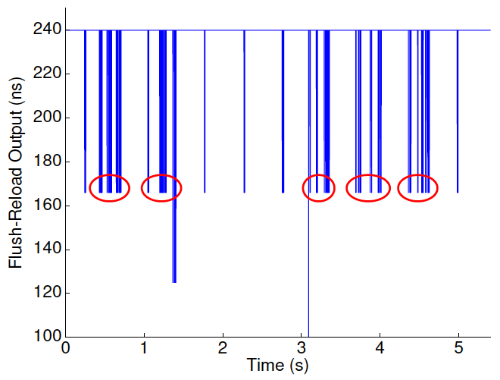
X. Zhang, Y. Xiao, Y. Zhang
Detecting Display Updates
learn inter-keystroke information

Slide 87
X. Zhang, Y. Xiao, Y. Zhang
Practical Considerations
CPU frequency scaling: maximum frequency
Power consumption: 1.5% battery per 20 min
Library version: 64 bit vs. 32 bit

Slide 88
X. Zhang, Y. Xiao, Y. Zhang
Countermeasures
Disallow userspace cache flushes
Restrict fine-grained time measurement
Prevent physical memory sharing

Slide 89
X. Zhang, Y. Xiao, Y. Zhang
OUTLINE
ARM Cache Exploration
Return-Oriented Flush-Reload Attacks on ARM
Case studies on Android
Conclusion

Slide 90
X. Zhang, Y. Xiao, Y. Zhang
Conclusion
Explored clearcache system call and cache inclusiveness on ARM
Designed a novel return-oriented Flush-Reload mechanism
Showed two categories of Flush-Reload attacks on Android devices

Slide 91
X. Zhang, Y. Xiao, Y. Zhang
Thanks for listening!
Xiaokuan Zhang
zhang.5840@osu.edu

Slide 93
LLC Flush-Reload Requirements: Flush(1)
VICTIM CORE
ATTACKER CORE
FLUSH
L1 CACHE
L2 CACHE

Slide 94
LLC Flush-Reload Requirements: Flush(1)
VICTIM CORE
ATTACKER CORE
RELOAD&TIME
L1 CACHE
L2 CACHE

Slide 95
LLC Flush-Reload Requirements: Flush(2)
VICTIM CORE
ATTACKER CORE
FLUSH
L1 CACHE
L2 CACHE

Slide 96
LLC Flush-Reload Requirements: Flush(2)
VICTIM CORE
ATTACKER CORE
FLUSH
L1 CACHE
L2 CACHE

Slide 97
LLC Flush-Reload Requirements: Flush(2)
VICTIM CORE
ATTACKER CORE
RELOAD&TIME
L1 CACHE
L2 CACHE

Slide 98
X. Zhang, Y, Xiao, Y. Zhang
Cache Inclusiveness
Experiment setup: Android App with NDK
One thread, 1K dummy function

Slide 99
X. Zhang, Y, Xiao, Y. Zhang
Cache Inclusiveness --- Instruction Cache
Execute Dummy
L1-I
L1-D
L1 CACHE
L2 CACHE

Slide 100
X. Zhang, Y, Xiao, Y. Zhang
Cache Inclusiveness --- Instruction Cache
Execute Dummy
L1-I
L1-D
L1 CACHE
T1: L1 Access Time
T1: L1 Access Time
T1: L1 Access Time
L2 CACHE

Slide 101
X. Zhang, Y, Xiao, Y. Zhang
Cache Inclusiveness --- Instruction Cache
L1-I
L1-D
Cleanse L2
Execute Dummy
L1 CACHE
T1: L1 Access Time
T1: L1 Access Time
T1: L1 Access Time
L2 CACHE

Slide 102
X. Zhang, Y, Xiao, Y. Zhang
Cache Inclusiveness --- Instruction Cache
L1-I
L1-D
Cleanse L2
Execute Dummy
L1 CACHE
T1: L1 Access Time
T1: L1 Access Time
T1: L1 Access Time
L2 CACHE

Slide 103

X. Zhang, Y, Xiao, Y. Zhang
Cache Inclusiveness --- Instruction Cache
L2 Inclusive to L1-I?
YES/NO
L1-I
L1-D
Cleanse L2
Execute Dummy
L1 CACHE
T1: L1 Access Time
T1: L1 Access Time
T1: L1 Access Time
L2 CACHE

Slide 104
X. Zhang, Y, Xiao, Y. Zhang
Cache Inclusiveness --- Instruction Cache
L2 Inclusive to L1-I?
YES
L1-I
L1-D
Cleanse L2
Execute Dummy
L1 CACHE
T1: L1 Access Time
T1: L1 Access Time
T1: L1 Access Time
L2 CACHE

Slide 105
X. Zhang, Y, Xiao, Y. Zhang
Cache Inclusiveness --- Instruction Cache
L2 Inclusive to L1-I?
YES
L1-I
L1-D
Cleanse L2
Execute Dummy
L1 CACHE
T1: L1 Access Time
T1: L1 Access Time
T1: L1 Access Time
L2 CACHE

Slide 106
X. Zhang, Y, Xiao, Y. Zhang
Cache Inclusiveness --- Instruction Cache
L2 Inclusive to L1-I?
YES
L1-I
L1-D
Cleanse L2
Execute Dummy
L1 CACHE
T1: L1 Access Time
T1: L1 Access Time
T1: L1 Access Time
L2 CACHE

Slide 107
X. Zhang, Y, Xiao, Y. Zhang
Cache Inclusiveness --- Instruction Cache
L2 Inclusive to L1-I?
YES
L1-I
L1-D
Cleanse L2
Execute Dummy
L1 CACHE
T1: L1 Access Time
L2 CACHE
T2: Mem Access Time

Slide 108
X. Zhang, Y, Xiao, Y. Zhang
Cache Inclusiveness --- Instruction Cache
L2 Inclusive to L1-I?
NO
L1-I
L1-D
Cleanse L2
Execute Dummy
L1 CACHE
T1: L1 Access Time
T1: L1 Access Time
L2 CACHE

Slide 109
X. Zhang, Y, Xiao, Y. Zhang
Cache Inclusiveness --- Instruction Cache
L2 Inclusive to L1-I?
NO
L1-I
L1-D
Cleanse L2
Execute Dummy
L1 CACHE
T1: L1 Access Time
T1: L1 Access Time
L2 CACHE

Slide 110
X. Zhang, Y, Xiao, Y. Zhang
Cache Inclusiveness --- Instruction Cache
L2 Inclusive to L1-I?
NO
L1-I
L1-D
Cleanse L2
Execute Dummy
L1 CACHE
T1: L1 Access Time
T1: L1 Access Time
L2 CACHE
T2: L1 Access Time
T2: Mem Access Time
T2: L1 Access Time

Slide 111
X. Zhang, Y. Xiao, Y. Zhang
Cache Inclusiveness
Smartphone |  | T1 | T2 | Inclusiveness
Krait 450 | D-cache | 1169 | 3700 | inclusive
 | I-cache | 1020 | 4350 | inclusive
Cortex-A15 | D-cache | 2600 | 6469 | inclusive
 | I-cache | 2484 | 5474 | inclusive
Cortex-A7 | D-cache | 3378 | 15460 | inclusive
 | I-cache | 3551 | 15822 | inclusive
Cortex-A57 | D-cache | 223 | 907 | inclusive
 | I-cache | 150 | 794 | inclusive
Cortex-A53 | D-cache | 325 | 1633 | inclusive
 | I-cache | 275 | 1287 | inclusive

